Slide 1
Assistive Technologies
What are they?
Notes:
Hello everyone, My name is Pamela Rodriguez. Today I will be discussing assistive technologies. First things first, What is assistive technology? Assistive technology is any tool that helps students with disabilities do things more quickly, easily or independently.

Slide 2
Individuals with Disabilities Education Act (IDEA)
If a student qualifies to benefit from Assistive Technologies:
A qualified evaluator must complete an assistive technology evaluation
If the evaluator recommends a device, it must be acquired
If a parent, student, or teacher needs training to use the device, that must also be provided
Photo credit to SalFalko
Notes:
The federal government revised the Individuals with Disabilities Education Act in 1997 and then again in 2004. This act states that schools must consider the disabilities of every student in special education and evaluate if there are any devices that will improve or at least maintain the student capabilities.

Slide 3
Areas in which Assistant Technologies can be beneficial
Mobility
Vision
Hearing
speech
Notes:
These are a few areas in which assistant technologies can aid students and teachers

Slide 4
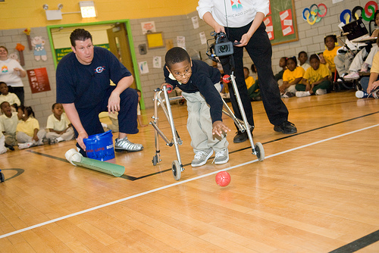
Mobility
Photo credit to Chicago 2016
Notes:
Assistive technologies for mobility impairment include wheelchairs and walkers.
Alternative keyboards are also a great tool. These keyboards are larger or smaller depending on the individuals needs.
There are also keyboards for people who have a difficulty using more than one key at a time.The use of StickyKeys allows keystrokes that are usually entered at the same time to be entered sequentially. On the other hand, FilterKeys can eliminate repeated keystrokes for a person who due to a difficulty tends to press a key for too long. This equipment is not only useful for students with a physical disability, but also for those with visual disabilities.

Slide 5
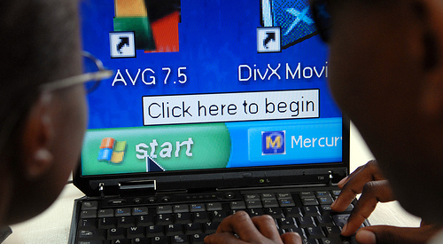
Vision
Photo credit to Tony Roberts
Notes:
Screen magnification is a software that enlarges the text on the computer screen.
Screen reader is another software, it reads everything on the screen aloud, including text, icons, and pull down menus.
Brail keyboards are also great tools that can aid a visually impaired students.

Slide 6
Hearing
Photo credit to UMHealthSystem
Notes:
FM Systems are wireless, portable, battery-operated devices that uses radio transmission to send auditory signals. The teacher in this case would wear the microphone and transmitter, and the student would wear the receiver.
A speech to text system may be used by a student to convert speech into text.
Hearing aids are of course a great option for these student as well.

Slide 7
Speech
Youtube
Notes:
This is a short video on a form of assistive technology used for aiding a student with speech impairment

Slide 8
Why is it so important for a student with disabilities to have access to assistive technologies?
Higher education
Social interactions
Future
Notes:
A person with a single or multiple disabilities has many daily struggles to face. If an education adds to those struggles, they are more likely to become frustrated and discontinue their education. It is important for schools, teachers, and parents to help make education an enjoyable experience.
If a student can overcome the difficulties their disability has put in their way, they are more able to interact with other students, as work with other students in group work and projects.
Their level of education and social interactions will have an affect of their future, their future job, family, and overall happiness.

Slide 9
US Adults 18 and older: Disability and functioning
(2011)
Disability |  | Percentage of population
Hearing Troubles |  | 16%
Vision Trouble |  | 9.2%
Physical functioning Difficulty |  | 16.2%

Slide 10
Resources:
"Assistive Technology for College Students." Technology Tools for Students Who Are Blind or Visually Impaired. N.p., n.d. Web. 24 Oct. 2013.
"Assistive Technology for Kids with LD: An Overview." GreatSchools. Greatschools.org, n.d. Web. 24 Oct. 2013.
"Assistve Technology Devices." PBS. PBS.org, n.d. Web. 24 Oct. 2013.
"Disability and Functioning (Adults)." Centers for Disease Control and Prevention. Centers for Disease Control and Prevention, 30 May 2013. Web. 24 Oct. 2013.
"Working Together: Computers and People with Mobility Impairments." University of Washington. N.p., n.d. Web. 24 Oct. 2013.

